Slide 1
Maze Project
Suxi Li

Slide 2
Table of Contents
Introduction
Design
Implementation
Test
Enhancement Ideas
Conclusion
References

Slide 3
Introduction
There is a ball in a maze with empty spaces and walls. The ball can go through empty spaces by rolling up, down, left or right, but it won't stop rolling until hitting a wall. When the ball stops, it could choose the next direction.
For this project, I am going to focus on using Depth-First Traversal Algorithm to find the shortest path for the same maze.

Slide 4
Design
Identify and understand the problems.
There is a ball in a maze with empty spaces and walls. The ball can go through empty spaces by rolling up, down, left or right, but it won't stop rolling until hitting a wall. When the ball stops, it could choose the next direction.
Given the ball's start position, the destination and the maze, determine whether the ball could stop at the destination.
The maze is represented by a binary 2D array. 1 means the wall and 0 means the empty space. You may assume that the borders of the maze are all walls. The start and destination coordinates are represented by row and column indexes.

Slide 5
Design
b. Investigate to find possible solutions which may include your own solution.
We can use the DFS method, assuming that each cell has four possibilities: up, down, left and right. One of the simplest solutions for traversal is to do a depth-first search. In this case, we choose one path at a time and go as far down the tree as possible before moving on to the next path. To achieve this, we use the recursive function DFS (maze, Start, Destination, visited). This function takes as arguments the given Maze array, the starting and destination locations, and the array accessed. Visited Array is a two-dimensional Boolean array that is the same size as Mazaze. The True value at visited[I][j]visited[I][j] indicates that the current location has been reached in advance during the path traversal. We use this array to keep track of repeated occurrences of the same path. When we reach a specific location in the maze, we mark True at the current location of the Visited array.
From each starting position, we can keep moving left, right, up or down until we reach a boundary or a wall. Therefore, from the starting position, we identify all reachable ends by choosing four directions. In each case, the new endpoint will now serve as a new starting point for traversal. The destination clearly hasn't changed. So now we call the same function four times in four directions, each time using the previously obtained new starting point.
If any of the function calls return True, it means we can reach our destination.

Slide 6
Design
c. Theoretically compare the solutions and select the best one.
We also can use BFS. To do this, we use a queue. We start with the starting position of the ball. For each current location, we add all possible new locations to the queue queue as new start locations by traversing all four directions (until we reach the wall or boundary) and mark these locations True in the Visited array. When all directions are covered, we remove a position value ss from the front of the queue queue and continue the same process with SS as the new starting position.
Additionally, to select the direction of movement, we use a dirdir array that contains four entries. Each term represents a one-dimensional direction of movement. To move in a particular direction, we keep adding specific entries to the dirs array until we hit a wall or a boundary. For a particular starting position, we add dirdir to all four possible directions.
If we arrive at the destination at any time, we return True, indicating that we can get there from the starting position.
So I select the DFS one.

Slide 7
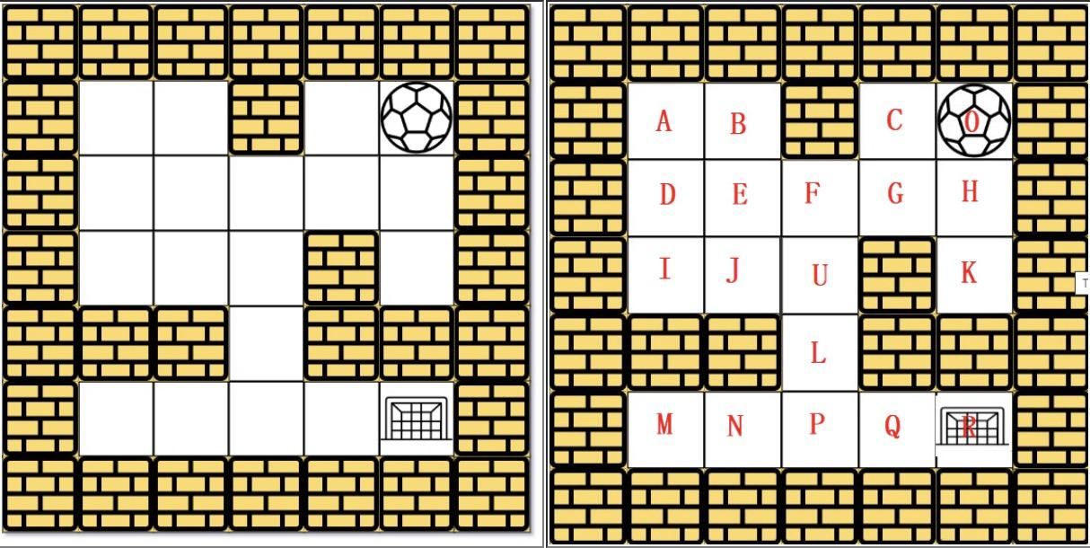
Implementation

Slide 8
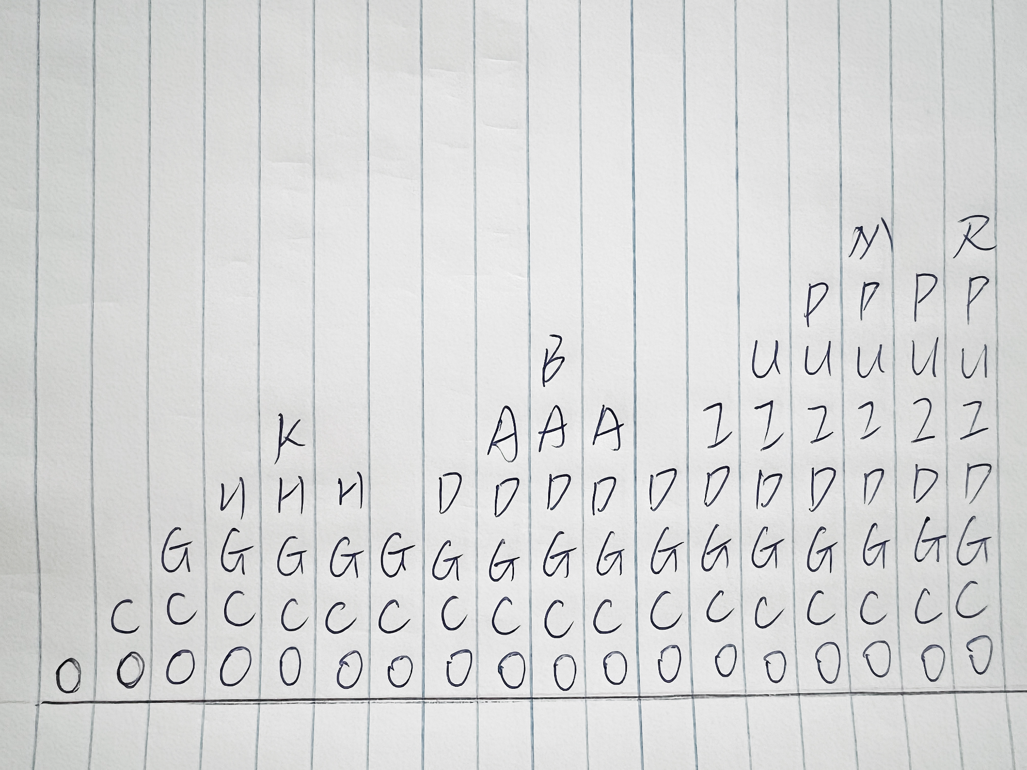
Implementation

Slide 9
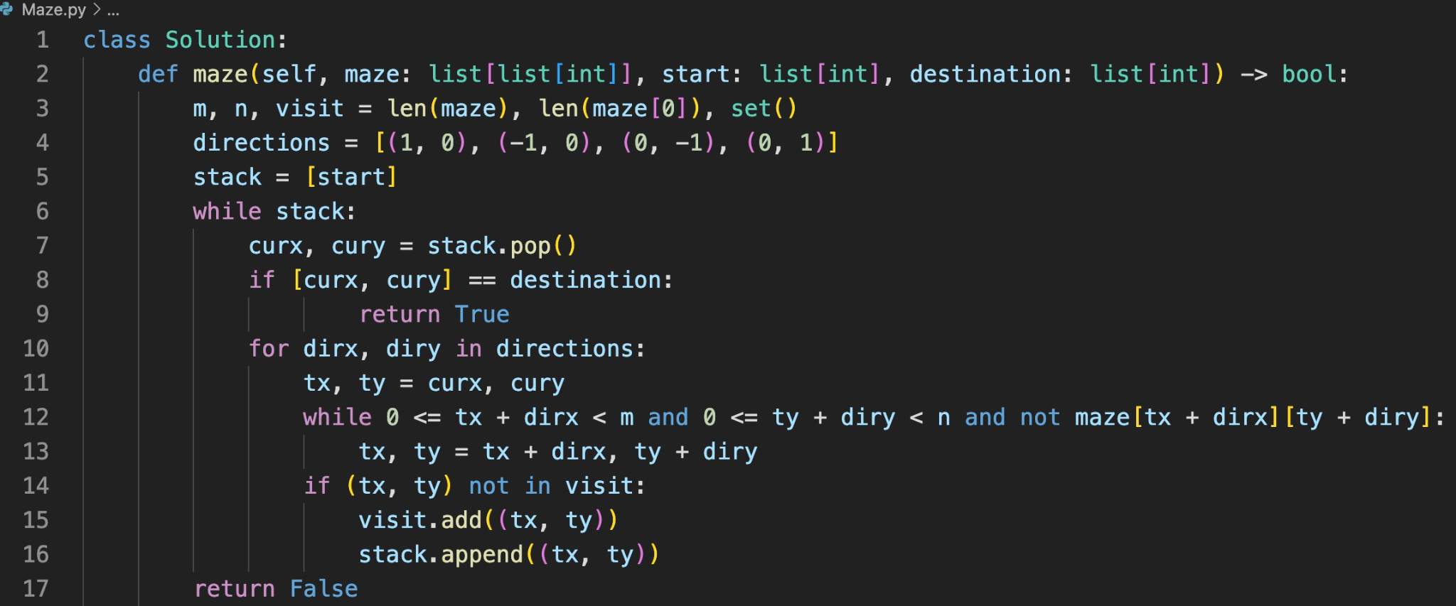
Implementation

Slide 10
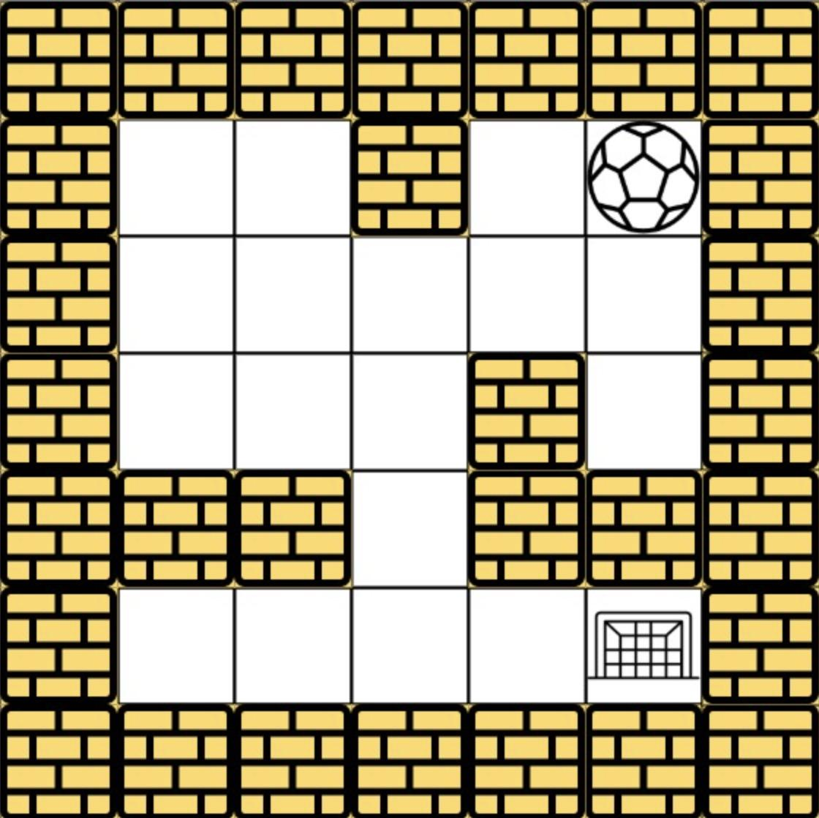
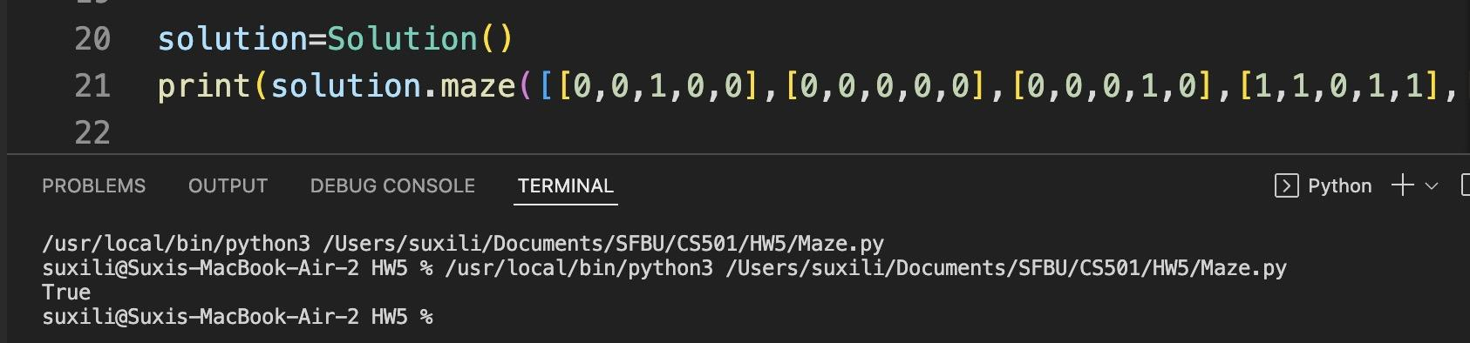
Test 1:
Input:
maze=[[0,0,1,0,0],[0,0,0,0,0],[0,0,0,1,0],[1,1,0,1,1],[0,0,0,0,0]], start = [0,4], destination = [4,4]
Explanation: One possible way is : left -> down -> left -> down -> right -> down -> right.
Output:

Slide 11
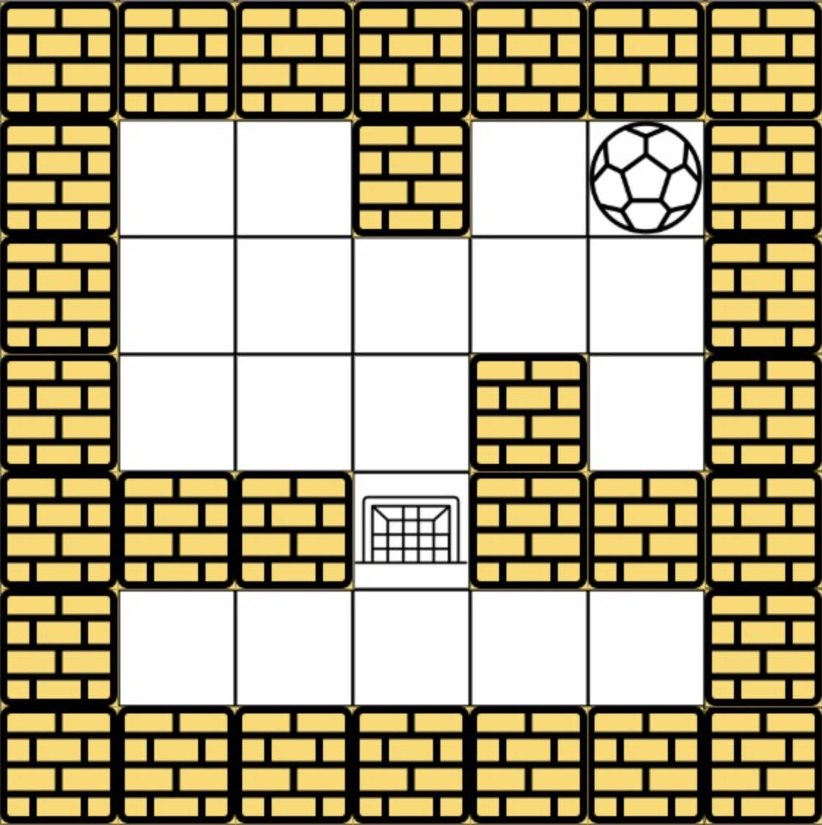
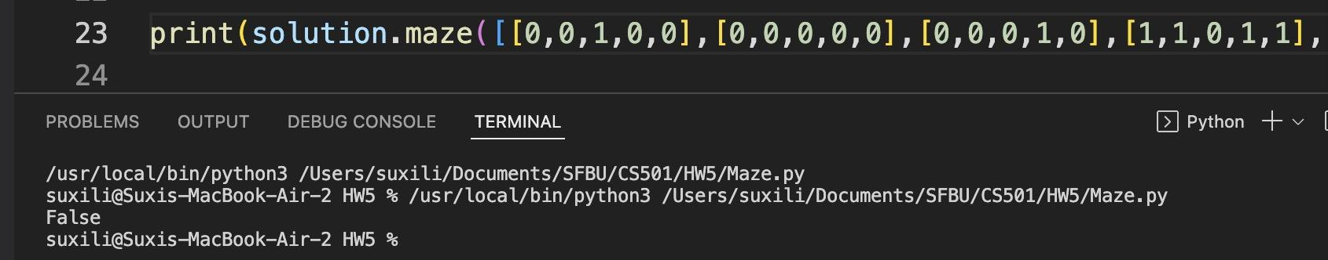
Test 2:
Input:
maze = [[0,0,1,0,0],[0,0,0,0,0],[0,0,0,1,0],[1,1,0,1,1],[0,0,0,0,0]], start = [0,4], destination = [3,2]
Explanation: There is no way for the ball to stop at the destination. Notice that you can pass through the destination but you cannot stop there.
Output:

Slide 12
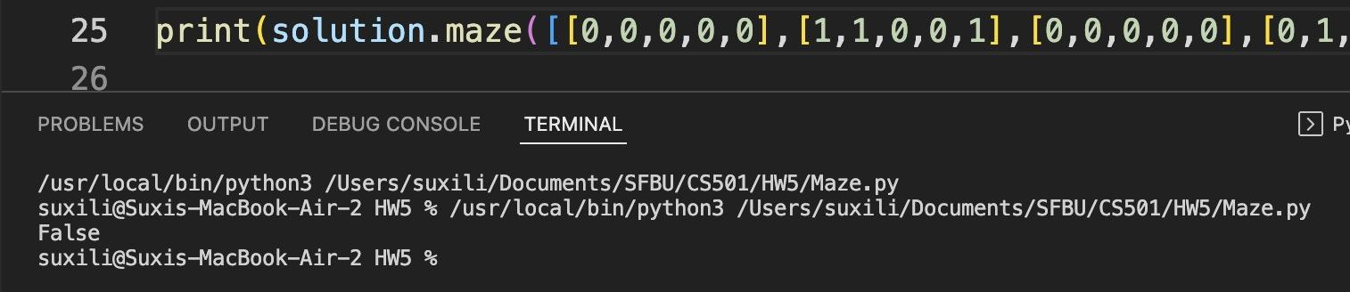
Test 3:
Input:
maze = [[0,0,0,0,0],[1,1,0,0,1],[0,0,0,0,0],[0,1,0,0,1],[0,1,0,0,0]], start = [4,3], destination = [0,1]
Explanation: There is no way for the ball to stop at the destination. Notice that you can pass through the destination but you cannot stop there.

Slide 13
Enhancement Ideas
At the end of a maze, find a way to avoid going to the end

Slide 14
Conclusion
From each starting position, we can keep moving left, right, up or down until we reach a boundary or a wall. Therefore, from the starting position, we identify all reachable ends by choosing four directions. In each case, the new endpoint will now serve as a new starting point for traversal. The destination clearly hasn't changed. So now we call the same function four times in four directions, each time using the previously obtained new starting point.
If any of the function calls return True, it means we can reach our destination.
Time complexity : O(mn)O(mn). Complete traversal of maze will be done in the worst case. Here, mm and nn refers to the number of rows and coloumns of the maze.
Space complexity : O(mn)O(mn). visited array of size m*nm∗n is used.

Slide 15
References
https://leetcode.com/problems/the-maze/
https://github.com/grandyang/leetcode/issues/490
https://www.geeksforgeeks.org/depth-first-search-or-dfs-for-a-graph/
https://www.youtube.com/watch?v=e_75Z90j0IM
https://www.youtube.com/watch?v=W9F8fDQj7Ok

